Slide 1
Code coverage
Code coverage is a measure used to describe the degree to which the source code of a program is executed when a particular test suite runs.
Code coverage is a way of ensuring that your tests are actually testing your code. When you run your tests you are presumably checking that you are getting the expected results. Code coverage will tell you how much of your code you exercised by running the test.

Slide 2
Statement coverage is the most basic form of code coverage. A statement is covered if it is executed.
Statement coverage is sometimes called line coverage
Covers all executable Statements

Slide 3
Statement coverage
Statement coverage is a white box testing technique, which involves the execution of all the statements at least once in the source code. It is a metric, which is used to calculate and measure the number of statements in the source code which have been executed
The statement coverage is also known as line coverage or segment coverage. The statement coverage covers only the true conditions.
Through statement coverage we can identify the statements executed and where the code is not executed because of blockage.
In this process each and every line of code needs to be checked and executed
(Statement coverage = No of statements Executed/Total no of statements in the source code * 100)

Slide 4
Advantage of statement coverage:
It verifies what the written code is expected to do and not to do
It measures the quality of code written
It checks the flow of different paths in the program and it also ensure that whether those path are tested or not.
Disadvantage of statement coverage:
It cannot test the false conditions.
It does not report that whether the loop reaches its termination condition.
It does not understand the logical operators.

Slide 5
Example:
Read A Read B if A>B Print “A is greater than B” else Print "B is greater than A" endif
Set1 :If A =5, B =2 No of statements Executed: 5 Total no of statements in the source code: 7 Statement coverage =5/7*100 = 71.00 %
Set1 :If A =2, B =5 No of statements Executed: 6 Total no of statements in the source code: 7 Statement coverage =6/7*100 = 85.20 %

Slide 6
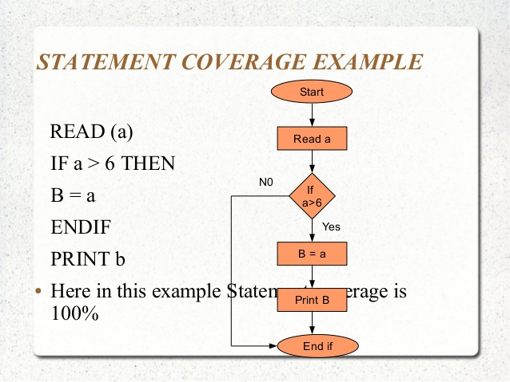

Slide 7
Branch coverage
Branch coverage is a testing method, which aims to ensure that each one of the possible branch from each decision point is executed at least once and thereby ensuring that all reachable code is executed. That is, every branch taken each way, true and false.
Branch coverage is also known as Decision coverage or all-edges coverage. It covers both the true and false conditions
Branch Testing = (Number of decisions outcomes tested / Total Number of decision Outcomes) x 100 %

Slide 8
Example
Read A
Read B
IF A+B > 10 THEN
Print "A+B is Large“
ENDIF
If A > 5 THEN
Print "A Large" ENDIF

Slide 9
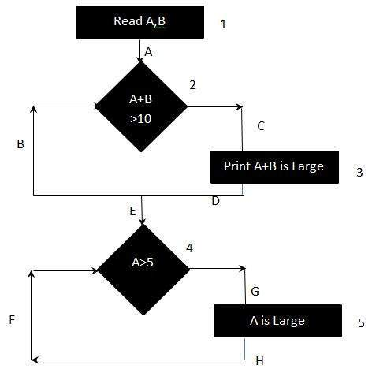

Slide 10
To calculate Branch Coverage, one has to find out the minimum number of paths which will ensure that all the edges are covered. In this case there is no single path which will ensure coverage of all the edges at once.
The aim is to cover all possible true/false decisions.
(1) 1A-2C-3D-E-4G-5H (2) 1A-2B-E-4F
Hence Branch Coverage is 2.

Slide 11
THANKU

